Slide 1


Team 60: Solar Lighting System
Bi-Weekly Update 5 Josh George, Jeb Malek, Lyric Haylow Sponsor: Dr. Wonhyeok Jang TA: Rhett Guthrie
Notes:
Michelle

Slide 2

Project Summary
A need for clean, renewable sources becomes more apparent than ever.
Our home indoor and outdoor lighting system is the first step towards this, using solar power.
Design an indoor/outdoor home lighting system that operates with a battery, power conversion, mobile application functionality, BT microcontroller for switch automation from motion sensors.
Notes:
Kyle

Slide 3
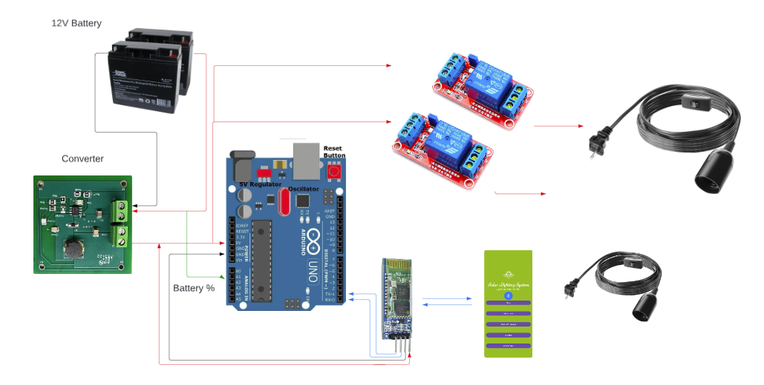
Integrated System Diagram
Notes:
Eric

Slide 4
Project Timeline
Subsystem Designs (completed 01/16) | Subsystems ordered and soldered (2/14) | Integration of Bluetooth and Arduino (3/18) | Integration of Solar Charge Controller and MCU (3/29) | Final Integration (to complete by 4/1) | System Test (to complete by 4/8) | Validation (to complete by 4/8) | Demo and Report (to complete by 4/17)
Notes:
Eric

Slide 5
Solar Charge Controller
Lyric Haylow
Accomplishments since last update 14 hrs of effort | Ongoing progress/problems and plans until the next presentation
Validated charging and fully charged systems are set. Validated board does not operate for faulty/wrong batteries New battery ordered Completed final design of the project | Issue with getting amp draw Test Charge Controller with new battery Test limits of solar panels given indoor and outdoor conditions Modify 3D print to fit battery chosen

Slide 6
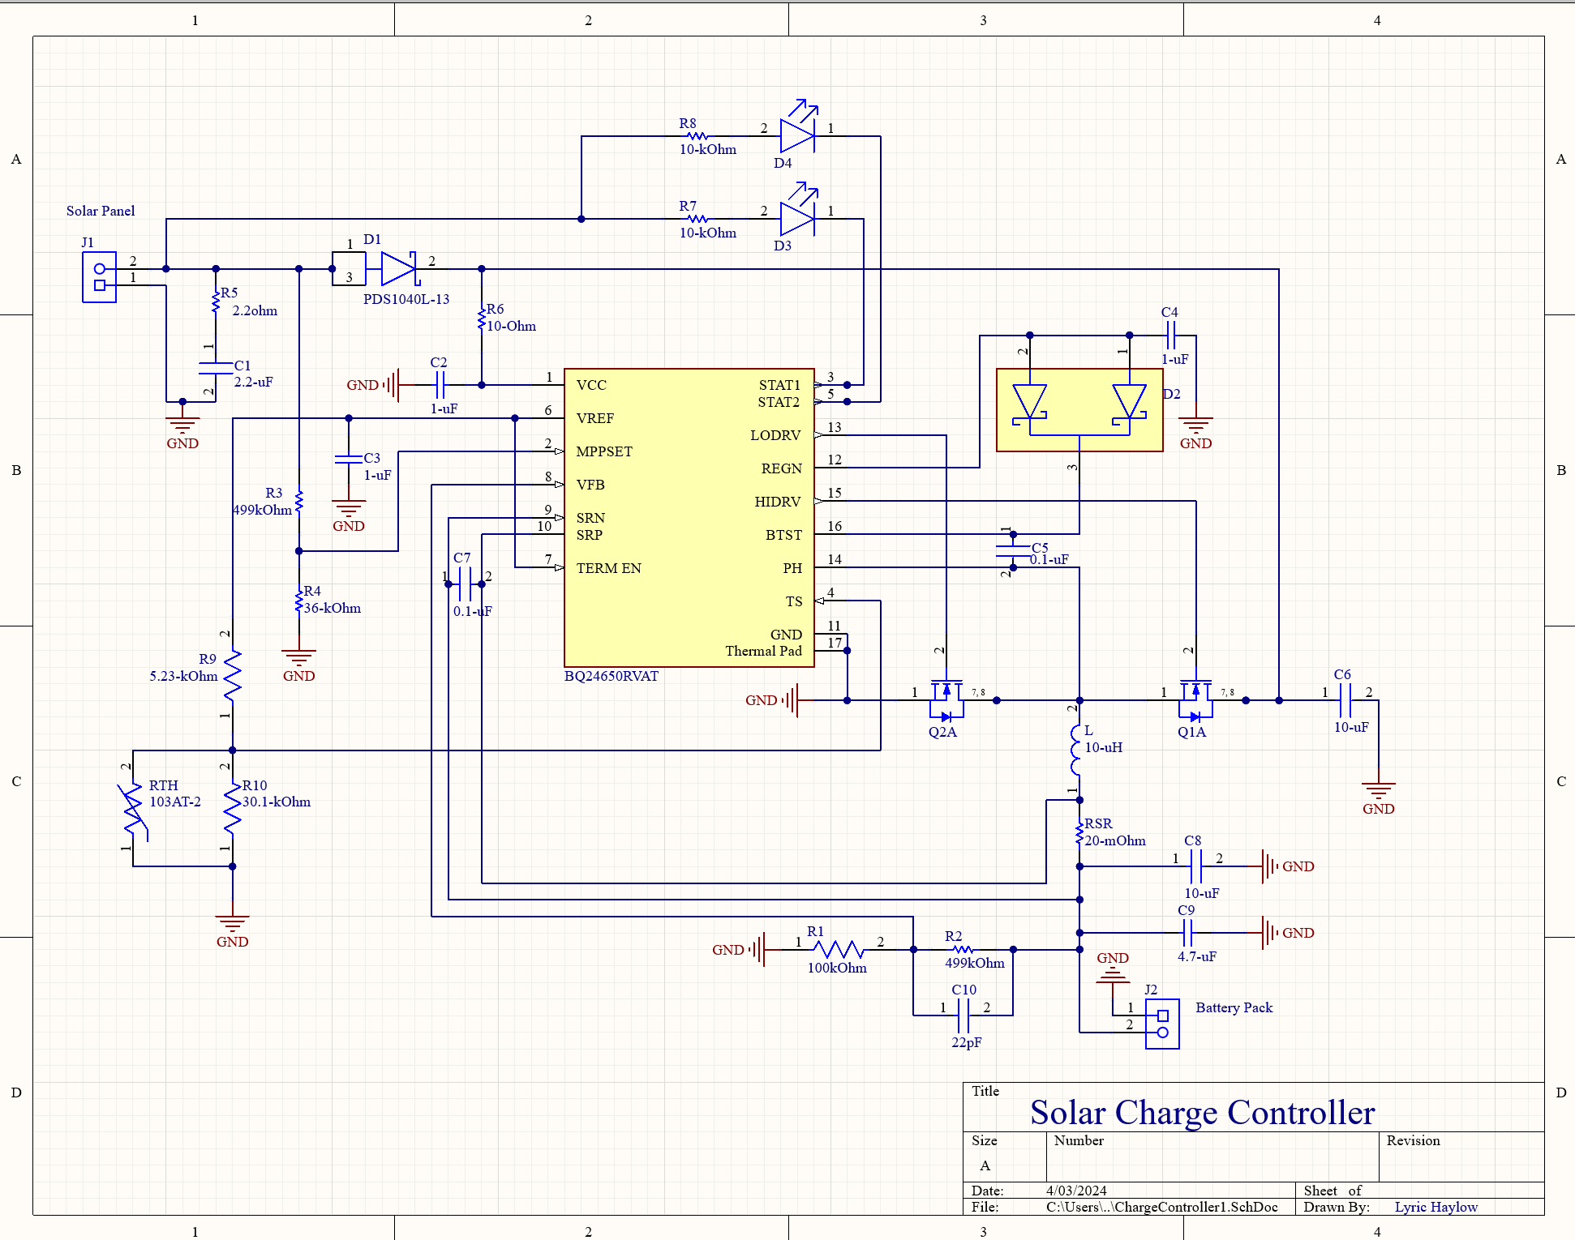
Solar Charge Controller
Lyric Haylow
Main Issue: Charge Controller reads charging, however no current is being pulled.
Fixes attempted:
Changing R3 and R4 values for better acclimation from input.
Changing R2 and R1 values to fit an expected Li-Ion battery input value of 8.4V
Hooking up Electronic Load to total system to pull load.

Slide 7
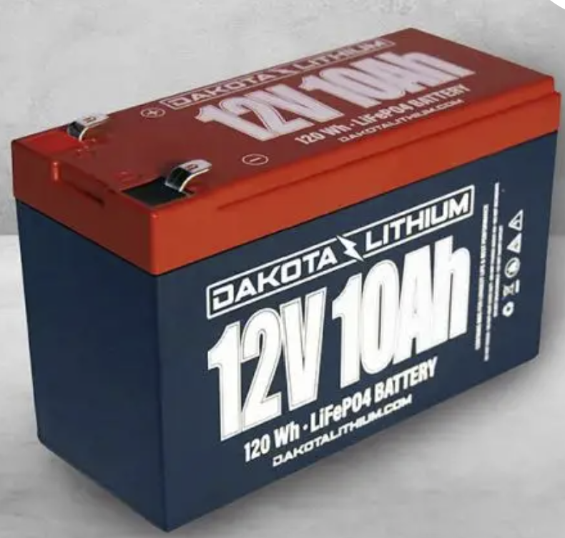
Solar Charge Controller
Lyric Haylow
Fixes to be attempted:
Trying Lithium Ion battery, should work for Wh amount necessary. Will require redesign of 3D print.
Switching Lead-Acid batteries used, there is a slight chance the one I've used is faulty, as shown by its low voltage value of 10.4V
Soldering is not an issue, as voltage values travel across the board and the board was personally checked by Dr. Lusher.

Slide 8
Power Subsystem
Jeb Malek
Accomplishments since 403 10 hrs of effort | Ongoing progress/problems and plans until the next presentation
Power Supply Verified | Converter Attach Arduino, Sensor, Light Loads
Tested Converter with 5A Fuse attached to Battery

Slide 9
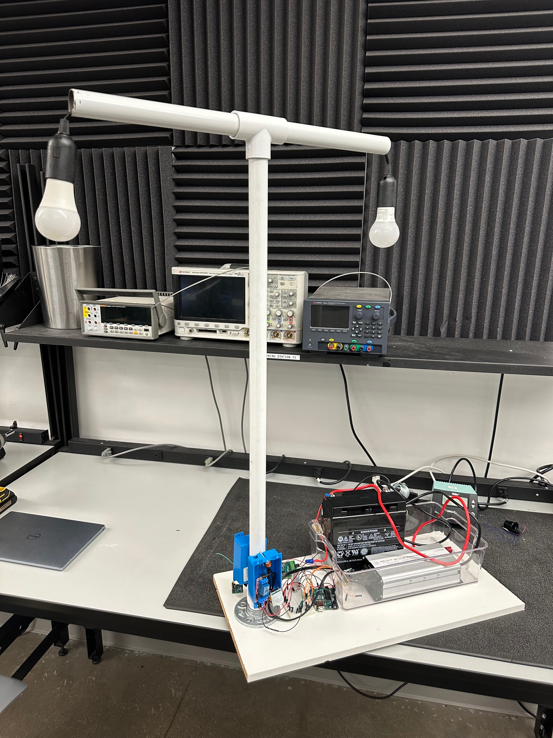
Power Subsytem
Jeb Malek
Testing & Verification of 12-5V Converter
Switch & Sensor Load Bench Supply
Switch , Sensor , Arduino , & BT Module
Battery Supply
Supply | 11V 1A
Voltage | 4.91 V
Current | 21 mA
Supply | 12.27V 1A
Voltage | 4.91 V
Current | 18.183 mA

Slide 10
Microcontroller Subsystem
Jeb Malek
Accomplishments since 403 10 hrs of effort | Ongoing progress/problems and plans until the next presentation
Testing of Bluetooth Signal Availability | Synchronization of switch operation and motion sensing with distance sensitivity. Bluetooth Communication with Android Software
Further Investigation of Time Delay and Switching Signal

Slide 11
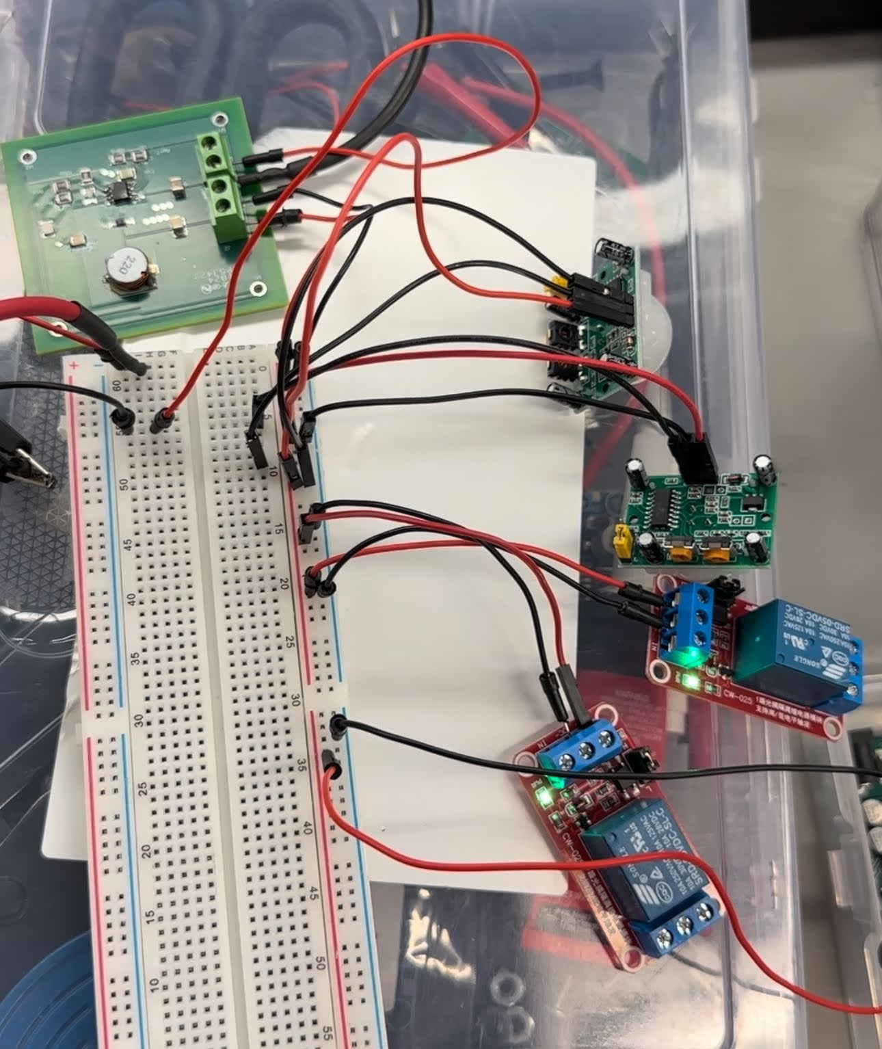
Microcontroller Subsytem
Jeb Malek
Arduino & Bluetooth Module Load
Supply | 11V 1A
Voltage | 4.998 V
Current | 37 mA
Power | 184-186 mW

Slide 12
Mobile Application
Josh George
Accomplishments since last update 5 hrs of effort | Ongoing progress/problems and plans until the next presentation
-Solved an issue where HC05 Bluetooth module was not discoverable by app. -Updated graphing page to be more user friendly and cleaner. -Added text explaining page. -Implemented graphic displaying relative charge percentage | -Begin testing microcontroller, lights, sensor, and app integration. -Find solution for obtaining battery percentage from solar charge controller.

Slide 13
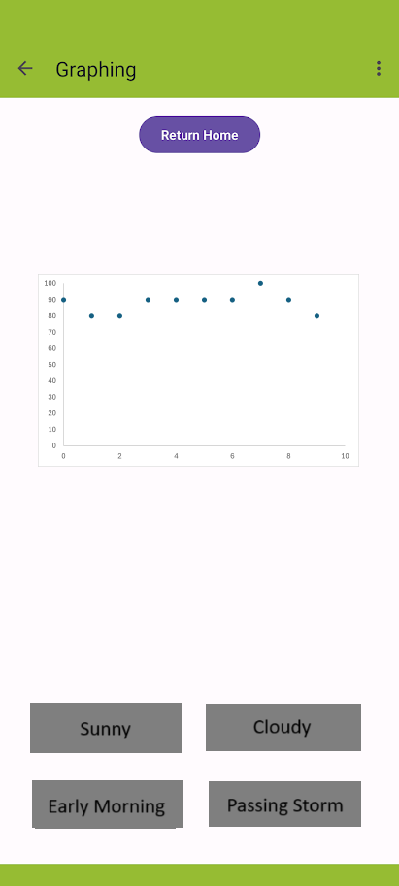
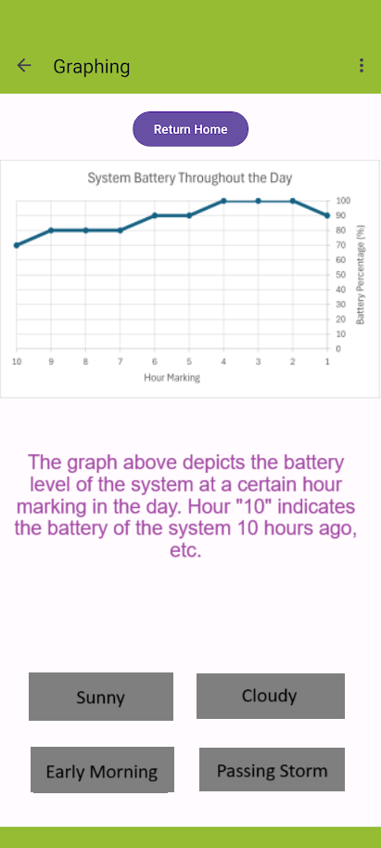
Mobile Application
Josh George
Old
New

Slide 14
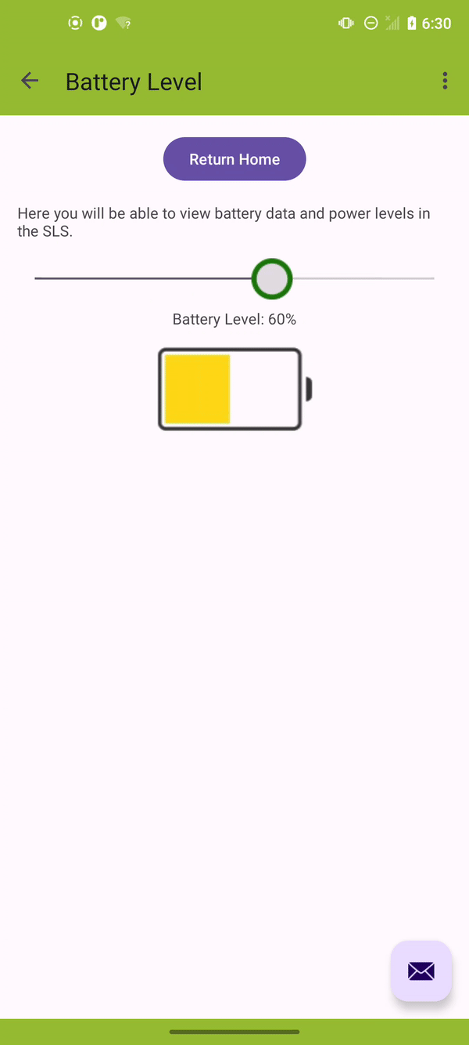
Mobile Application
Josh George

Slide 15
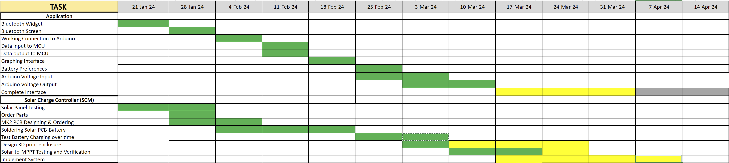
Execution Plan

Slide 16
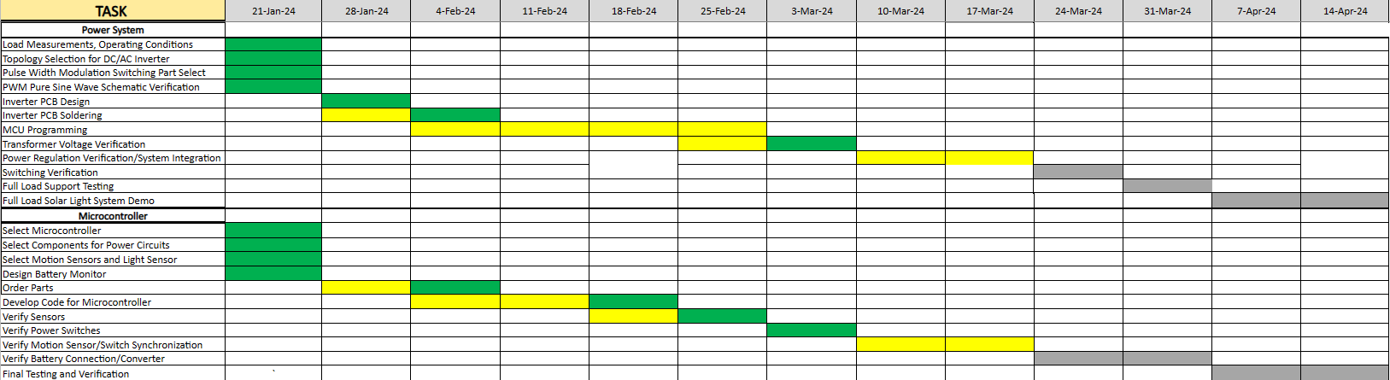
Execution Plan

Slide 17
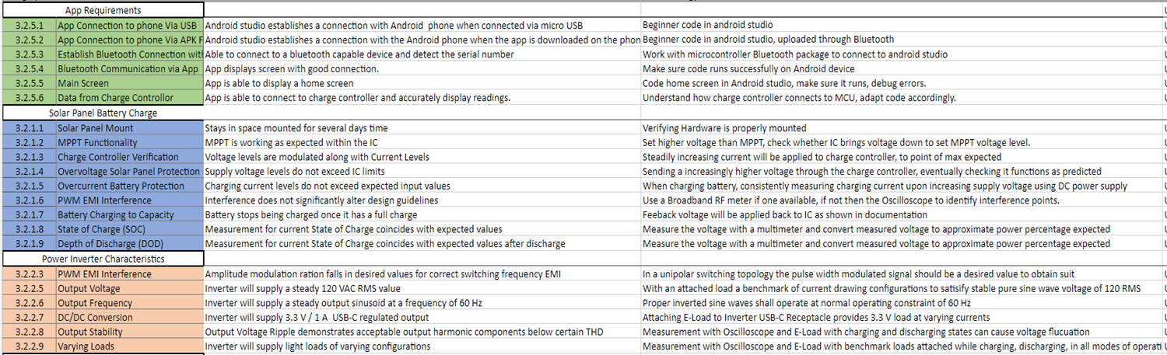
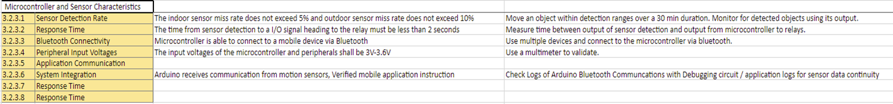
Validation Plan

